Slide 1




Network Infrastructure for
UThukela District Main Hospital
Presented by: ProTech Team

Slide 2

Value Addition:
Enhances operational efficiency, improves patient care, and ensures data security.
Alignment with Strategic Priorities:
Supports the Thukela District Municipality’s goal of improving healthcare services and digital infrastructure.
Expected Results:
Reliable network connectivity, improved data management, and enhanced security measures.
Deliverables:
Network design and installation, upgraded IT equipment, security systems, and staff training.
structure, missing patient files, and insufficient security measures.
OVERVIEW
Benefits:
Improved hospital operations, better patient care, secure data management, and increased staff efficiency.
Problems Resolved:
Outdated IT infrastructure, missing patient files, and insufficient security measures.

Slide 3



01
Key Challenges
Project Limits
Limited network providers, remote area
Outdated equipment and missing security
Insufficient ICT staff training
Data management issues
Reliance on one network provider
Limited technician access due to location
Budget constraints for upgrades
One-year timeline for completion

Slide 4
02
Security Measures
01
Firewalls, intrusion detection systems
02
Regular audits and vulnerability checks
03
Staff training on data protection
04
Encrypted and backed-up data storage

Slide 5
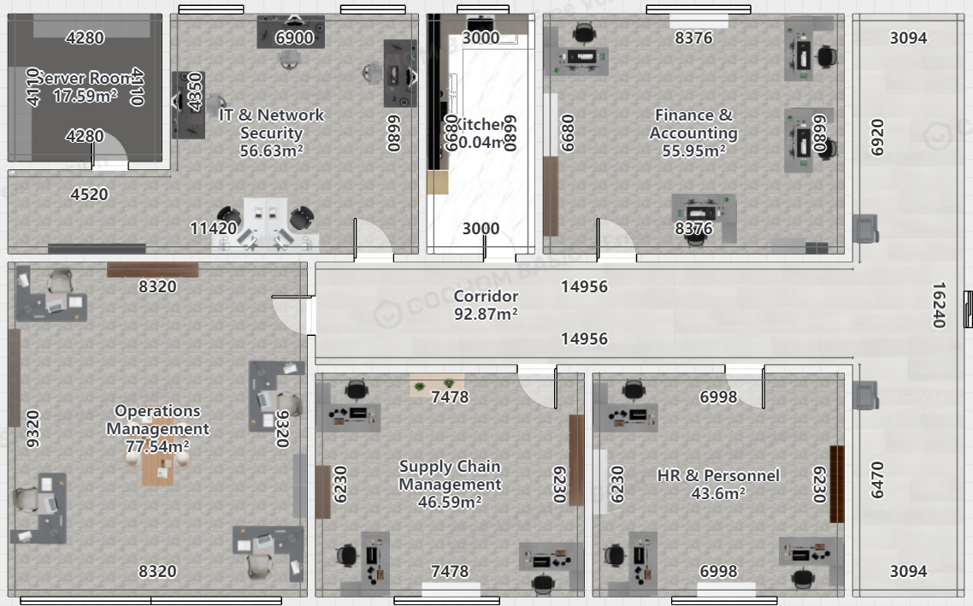
03
FLOOR PLAN

Slide 6
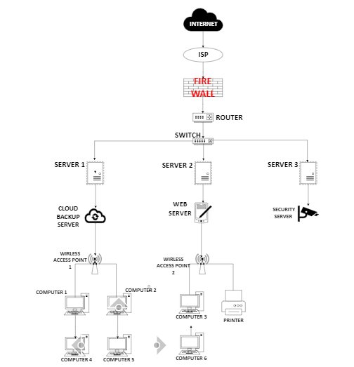
04
Network Diagram

Slide 7
05
Description of Components
• Internet: External connection to the world wide web.​
• ISP (Openserve): Service provider providing internet access.​
• Firewall: Protects network by filtering traffic and preventing unauthorized access.​
• Router: Manages traffic between internal and external internet.​
• Switch: Connects devices within the network.​
​
Servers:
• Server 1 (Database - SQL): Hosts hospital’s database.
• Server 2 (Application - ERP): Runs enterprise resource planning software.
• Server 3 (File Server): Stores documents and files.
• Backup Server (Cloud Backup): Provides redundancy for critical data.
• Web Server: Handles requests for hospital website access and external communication.
• Security Server: Monitors network for suspicious activity and manages security protocols.

Slide 8
05
Continuation...
Computers:
• Admin Staff Computers: Used for administrative tasks.
• Medical Staff Computers: Used for accessing patient information.
• Nurse Station Computers: Central stations for monitoring patient data.
• Printers: Printer 1 (Laser): Used for printing documents.
Additional Network Considerations:
• Network Security Measures: Implement firewalls, antivirus software, intrusion detection systems.
• Redundancy and Backup: Implement redundant systems.
• Staff Training: Train staff in cybersecurity protocols and network usage efficiency.

Slide 9

06
Budget Overview
Resource | Constraints
Project Budget | R 2,500,000
Network Engineers | R 500,000
IT Support Staff | R 400,000
Training Specialists | R 150,000
Security Experts. | R 300,000

Slide 10
Project Milestones
Milestones | Deliverables | Date
Project Initiation | Kick-off meeting, Stakeholder engagement | August 15, 2024
Planning | Approved network design, Equipment procurement | September 30, 2024
Implementation | Installed network, Setup IT equipment, Security systems in place | January 31, 2025
Training | Training materials, Completed training sessions | February 28, 2025
Closure | Final testing, Project documentation, Handover | March 31, 2025

Slide 11

Conclusion
By addressing connectivity, security, and training needs, we are not only improving daily operations but ensuring sustainable, long-term growth. With this infrastructure in place, the hospital will be better equipped to meet future challenges and continue serving the community with excellence. Thank you for your attention and support for this important initiative.

